Slide 1
Intro to RISC-V

Slide 2
The RISC-V Instruction Set Architecture
The RISC-V Instruction Set Architecture
Elements of Architecture: Registers
Add/Sub Instructions
Immediates

Slide 3

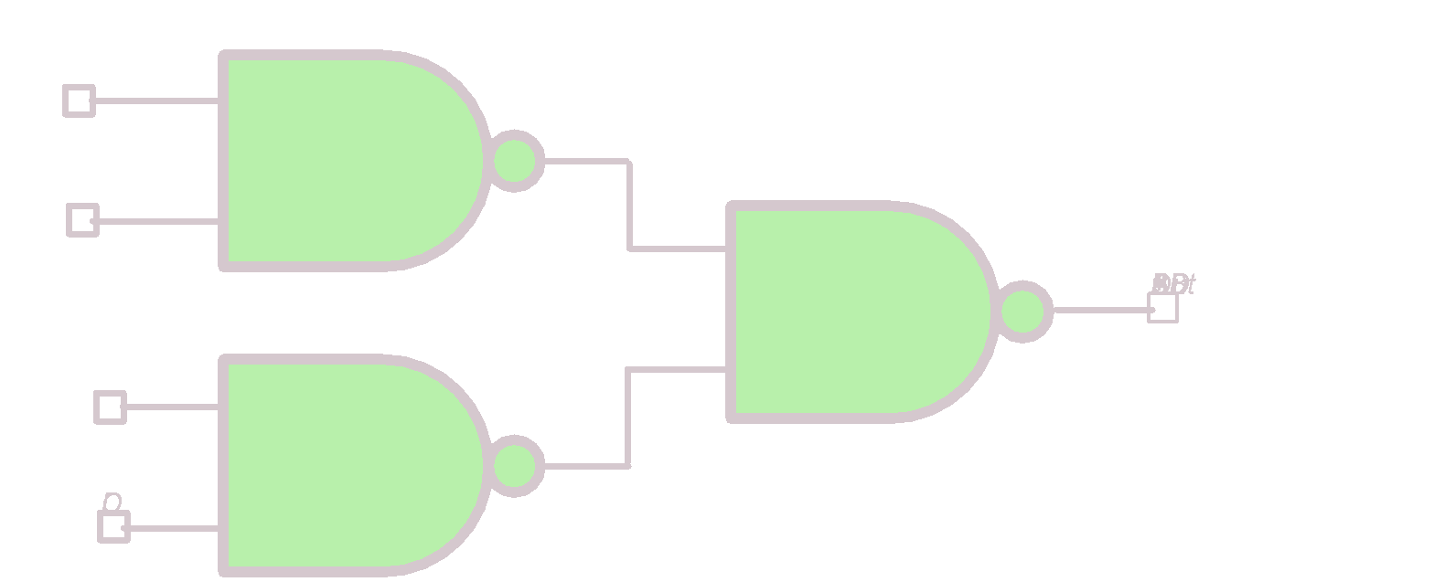
Great Idea #1: Abstraction (Levels of Representation/Interpretation)
High Level Language Program (e.g., C)
temp = v[k];
v[k] = v[k+1];
v[k+1] = temp;
Compiler
Anything can be represented as a number, i.e., data or instructions
Assembly Language Program (e.g., RISC-V)
lw x3, 0(x10)
lw x4, 4(x10)
sw x4, 0(x10)
sw x3, 4(x10)
Assembler
1000 1101 1110 0010 0000 0000 0000 0000
1000 1110 0001 0000 0000 0000 0000 0100
1010 1110 0001 0010 0000 0000 0000 0000
1010 1101 1110 0010 0000 0000 0000 0100
Machine Language Program (RISC-V)
Hardware Architecture Description (e.g., block diagrams)
+4
Reg
[]
pc
pc+4
1
wb
DataD
Reg
[rs1]
1
ALU
alu
2
alu
0
pc
IMEM
inst
[11:7]
AddrD
Reg
[rs2]
0
Addr
DMEM
1
wb
pc+4
inst
[19:15]
AddrA
DataA
Branch
0
DataW
DataR
mem
0
Architecture Implementation
inst
[24:20]
AddrB
DataB
Comp.
1
Logic Circuit Description (Circuit Schematic Diagrams)
inst
[31:7]
Imm
.
imm
[31:0]
Gen

Slide 4
Assembly Language
Basic job of a CPU: execute lots of instructions
Instructions are the primitive operations that the CPU may execute
Like a sentence: operations (verbs) applied to operands (objects), processed in sequence …
Different CPUs implement different sets of instructions. The set of instructions a particular CPU implements is an Instruction Set Architecture (ISA)
Examples: ARM (cell phones), Intel x86 (i9, i7, i5, i3), IBM/Motorola PowerPC (old Macs), MIPS, RISC-V, ...

Slide 5

Book: Programming From the Ground Up
“A new book was just released which is based on a new concept – teaching computer science through assembly language (Linux x86 assembly language, to be exact). This book teaches how the machine itself operates, rather than just the language. I've found that the key difference between mediocre and excellent programmers is whether or not they know assembly language. Those that do tend to understand computers themselves at a much deeper level. Although [almost!] unheard of today, this concept isn't really all that new -- there used to not be much choice in years past. Apple computers came with only BASIC and assembly language, and there were books available on assembly language for kids. This is why the old-timers are often viewed as 'wizards': they had to know assembly language programming.” -- slashdot.org comment, 2004-02-05

Slide 6
Instruction Set Architectures
Early trend was to add more and more instructions to new CPUs to do elaborate operations
VAX architecture had an instruction to multiply polynomials!
Reduced Instruction Set Computer (RISC) philosophy:
Cocke IBM, Patterson, Hennessy, 1980s.
Keep the instruction set small and simple, makes it easier to build fast hardware
Let software do complicated operations by composing simpler ones
This went against the conventional wisdom of the time (he who laughs last, laughs best)
Notes:
https://en.wikipedia.org/wiki/VAX
John Cocke IBM 801 1980 - This was not well publicized as it was an internal company project.
John Hennessey Stanford MIPS 1981
David Patterson Berkeley RISC 1980

Slide 7

Patterson and Hennessy win Turing!
https://engineering.berkeley.edu/news/2018/06/patterson-wins-turing-award/
Notes:
2017: For pioneering a systematic, quantitative approach to the design and evaluation of computer architectures with enduring impact on the microprocessor industry.
Patterson first met John Hennessy at a meeting for DARPA funded research VLSI projects in 1980 or 1981 where each was presenting their ideas. RISC-2 emerged simultaneously with Hennessy’s MIPS (Microprocessor without Interlocked Pipeline Stages) prototype at Stanford in 1983. Arguments between RISC vs. MIPS designs were soon dwarfed by their common thesis against CISC (Complex Instruction Set Computers), used by the entire industrial computer design community.
https://amturing.acm.org/award_winners/patterson_2316693.cfm
https://amturing.acm.org/award_winners/hennessy_1426931.cfm

Slide 8
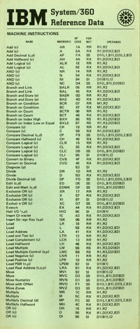
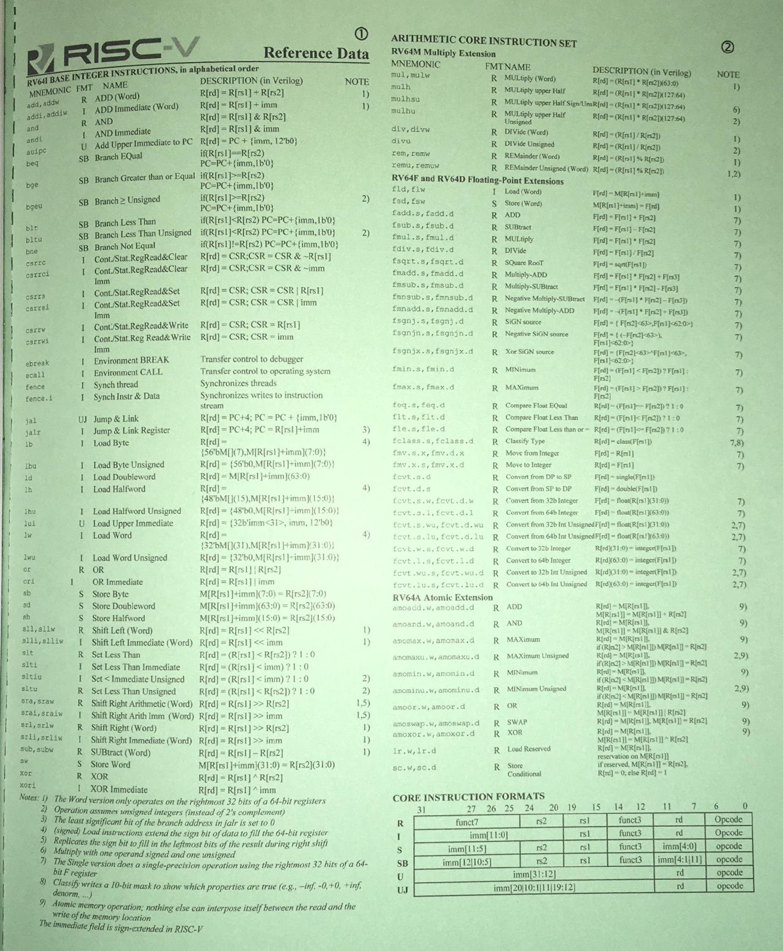
RISC-V Architecture
IBM 360 Green Card
New open-source, license-free ISA spec
Supported by growing shared software ecosystem
Appropriate for all levels of computing system, from microcontrollers to supercomputers
32-bit, 64-bit, and 128-bit variants (class/textbook uses 32-bit)
Why RISC-V instead of Intel x86-64?
RISC-V is simple and elegant. We don’t need to get bogged down in gritty details
RISC-V has exponential adoption, from microcontrollers to CPUs to warehouse-scale computers
https://cs61c.org/ 🡪 Resources
RISC-V Green Card

Slide 9
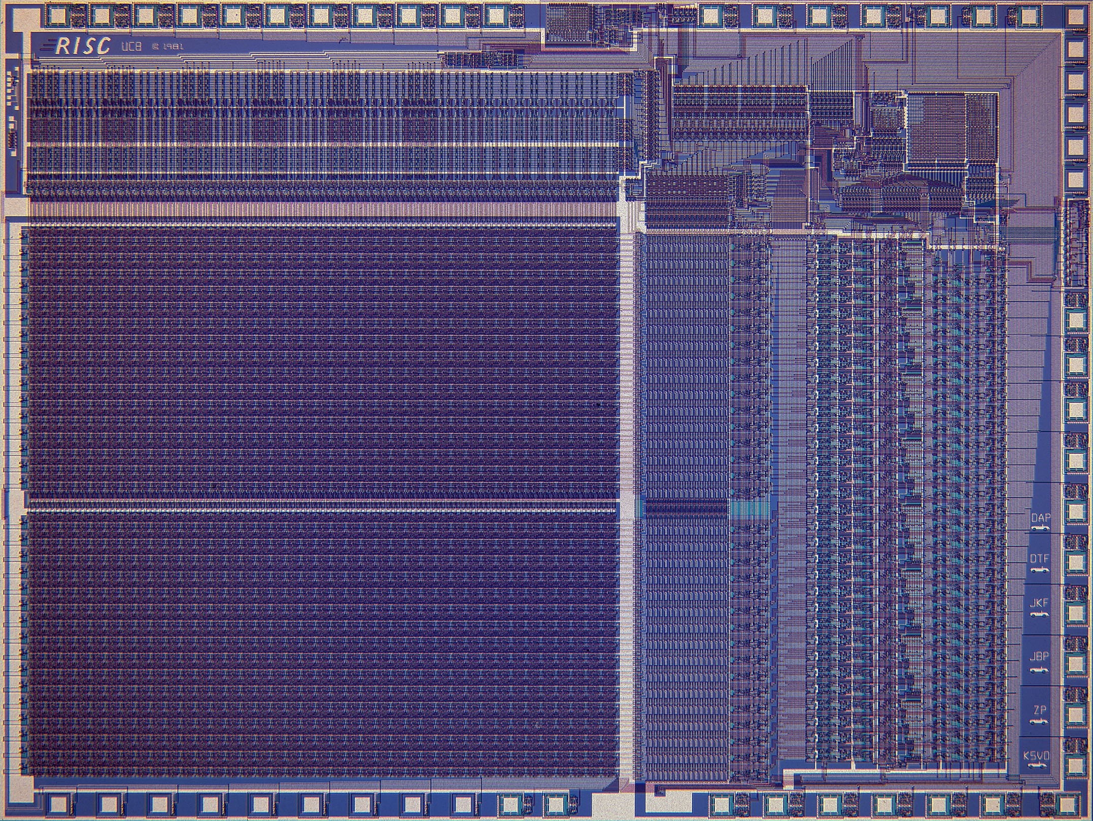
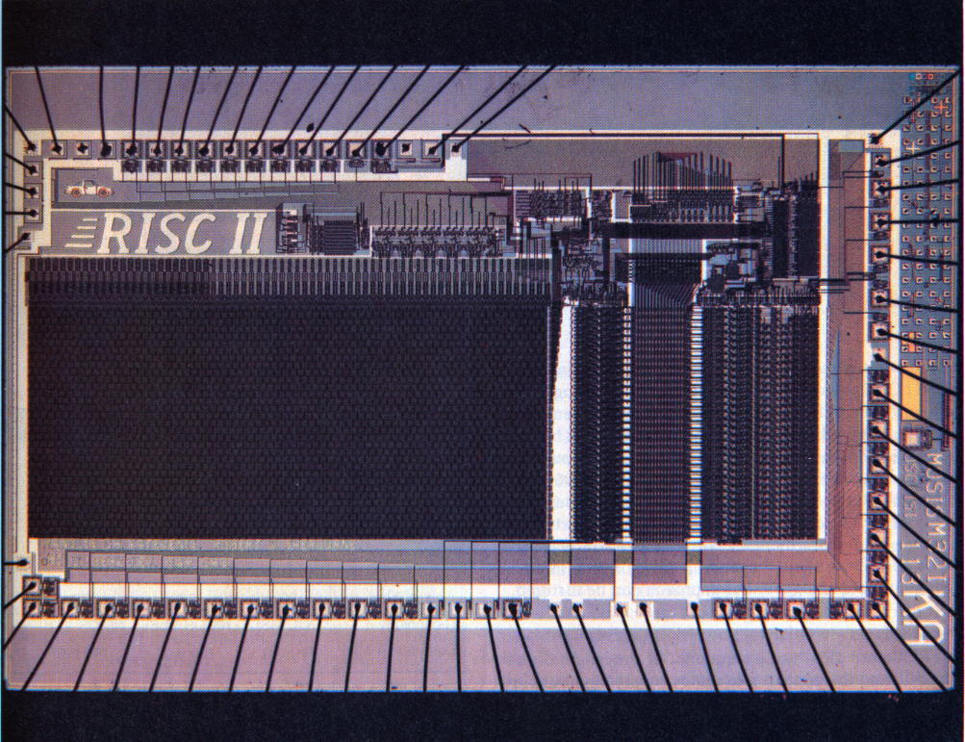

RISC-V Origins
Started in Summer 2010 to support open research and teaching at UC Berkeley
Lineage can be traced to RISC-I/II projects (1980s)
As the project matured, it migrated to RISC-V foundation (www.risc-v.org)
Many commercial and research projects based on RISC-V
Open-source and proprietary
Widely used in education
Read more:
https://riscv.org/risc-v-history/
https://riscv.org/risc-v-genealogy/
RISC-I
RISC-II

Slide 10
Elements of Architecture: Registers
The RISC-V Instruction Set Architecture
Elements of Architecture: Registers
Add/Sub Instructions
Immediates

Slide 11
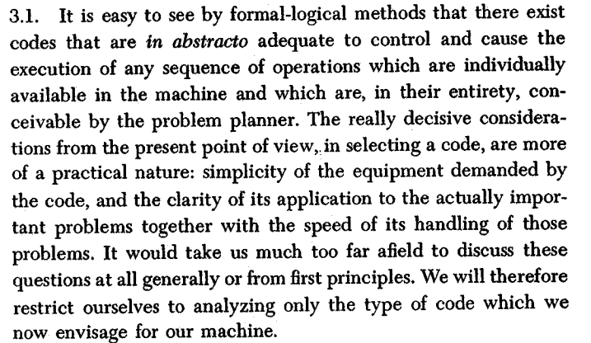
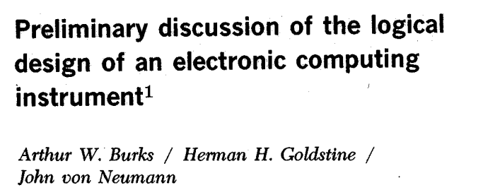
Instruction Set
“instruction sets”
Instruction set for a particular architecture (e.g. RISC-V) is represented by the assembly language
Each line of assembly code represents one instruction for the computer
add x1, x2, x3
operation name
registers

Slide 12
Higher-Level Language vs. Assembly Language (1/2)
C, Java
RISC-V
In C (and most high-level languages), variables declared first and given a type
int fahr, celsius; char a, b, c, d, e;
Each variable can ONLY represent a value of the type it was declared as (cannot mix/match int/char variables)
In high-level languages, variable types determine operation
int *p = …; p = p + 2; int x = 42; x = 3 * x;
Assembly operands are registers
Registers are limited number of special locations, built directly into the hardware
RISC-V: Operations can only be performed on register operands
In assembly language, the registers have no type
Register contents are just bits
Operation determines “type,” i.e., how register contents are treated
E.g., as value, memory address, etc.

Slide 13
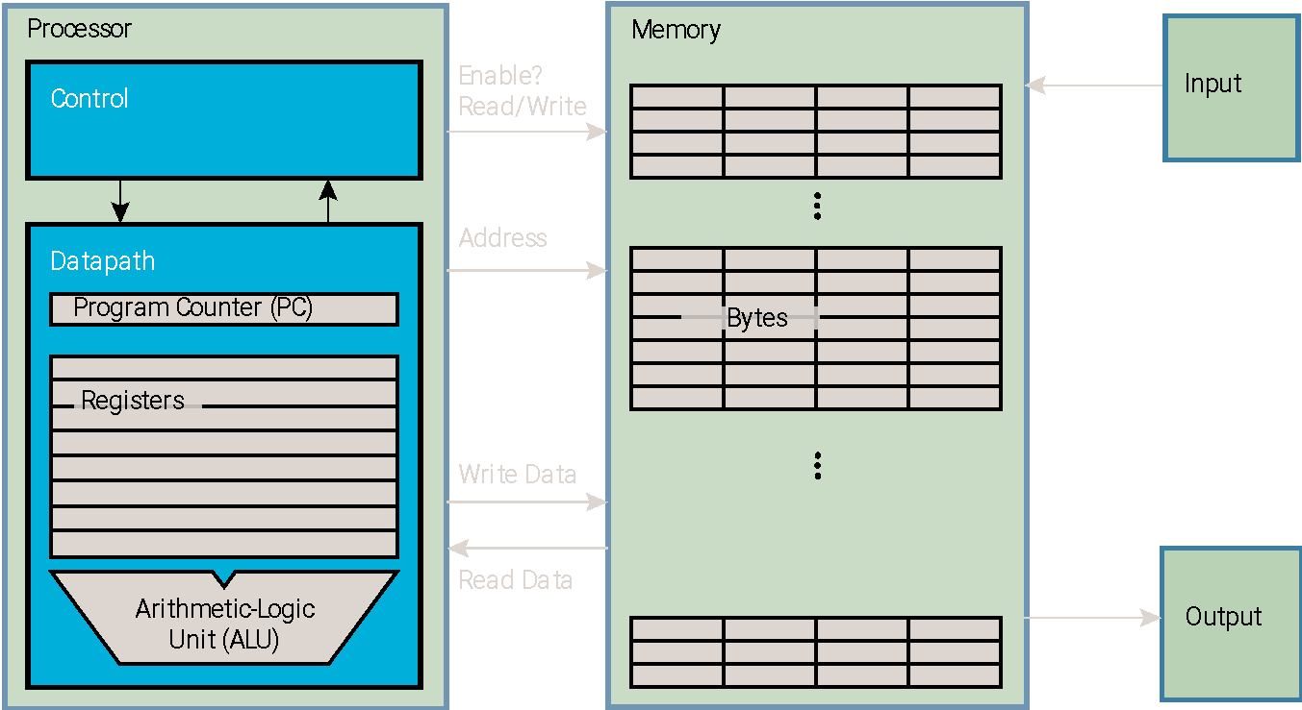
Registers are Inside the Processor
Benefit: Since registers are directly in hardware, they’re very fast (faster than 0.25ns)
Speed of light: 3x10⁸m/s = 0.3m/ns = 30cm/ns = 10cm/0.3ns!!!
0.3ns is the clock period of a 3.33GHz computer
Processor-Memory Interface
I/O-Memory Interfaces
Notes:
Apple M1 Chip is 3.1 GHz max clock rate
7/10 nm transistor density

Slide 14
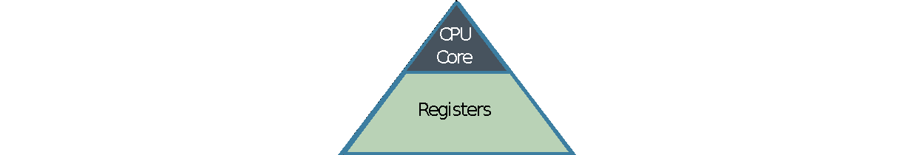
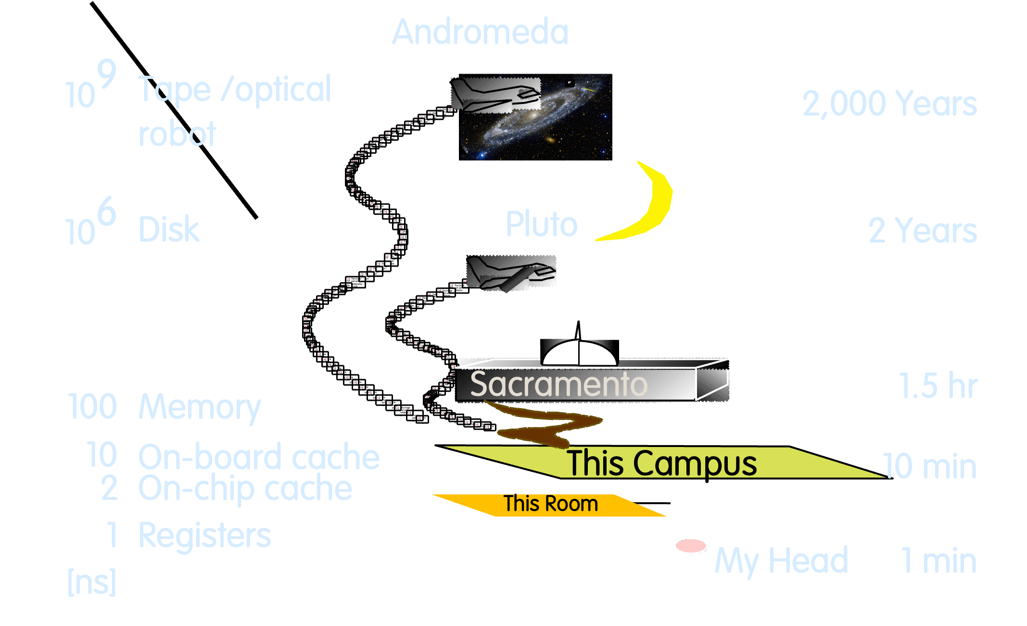
Great Idea #3: Principle of Locality / Memory Hierarchy
Processor chip
Extremely fast
Extremely expensive Tiny capacity
Storage Latency Analogy

Slide 15
32 Registers in RISC-V
Drawback: Each ISA a predetermined number of registers
Why? Registers are built into hardware
Solution: RISC-V code must be very carefully put together to efficiently use registers
Nowadays: compiler maps C variables to RISC-V registers across declarations, function calls, etc.
32 registers in RISC-V
Why 32? Smaller is faster, but too small is bad
Goldilocks principle (“This porridge is too hot; This porridge is too cold; this porridge is just right”)
Each RISC-V register is 32 bits wide (in RV32 variant)
Groups of 32 bits called a word in RV32

Slide 16
Register Names and Numbers
Registers are numbered from 0 to 31
Referred to by number x0 – x31
x0 is special, always holds value zero
So only 31 registers able to hold variable values
Each register can be referred to by number or name
We’ll explain names next week
Ok, enough already…give me my RV32!

Slide 17
Add/Sub Instructions
The RISC-V Instruction Set Architecture
Elements of Architecture: Registers
Add/Sub Instructions
Immediates

Slide 18
Higher-Level Language vs. Assembly Language (2/2)
C, Java
RISC-V
Each line can contain multiple operations
a = b * 2 - (arr[2] + *p);
Common operations are:
=, +, –, *, /
Here, * includes both multiply and dereference
Each statement is an instruction
An instruction executes exactly one short list of simple commands
Each line of assembly code contains at most 1 instruction
add x1, x2, x3
sub x1, x1, x4
The compiler translates from higher-level language down to assembly… …so RISC-V instructions are often closely related to common C/Java operations.

Slide 19
RISC-V Arithmetic Instruction Syntax
opname rd, rs1, rs2
operation, by name
”destination”
operand getting result
”source1”
1st operand for operation
”source2”
2nd operand for operation
Syntax is rigid:
1 operator, 3 operands
Why? Keep hardware simple via regularity (more in a few weeks)

Slide 20
RISC-V Addition and Subtraction
opname rd, rs1, rs2
operation, by name
”destination”
operand getting result
”source1”
1st operand for operation
”source2”
2nd operand for operation
Addition
Subtraction
add x1,x2,x3
a = b + c;
RISC-V
C
RISC-V
C
sub x4,x5,x6
d = e – f;
(remember!
order of operands matter in sub)

Slide 21
RISC-V Arithmetic, Example 1
How could we translate this C statement?
a = b + c + d - e;
Assume the above mapping for C variables ↔︎ RISC-V registers.
Solution: Break into multiple instructions!
add x10, x1, x2 # a_temp = b + c
add x10, x10, x3 # a_temp = a_temp + d
sub x10, x10, x4 # a = a_temp - e
x10 x1 x2 x3 x4
A single line of C may break up into several lines of RISC-V.
In-line comments prefixed by #, work like C99’s //.
Unlike C, no multi-line comment (/* */) support.

Slide 22
RISC-V Arithmetic, Example 2
How do we do this?
f = (g + h) - (i + j);
Assume the above mapping for C variables ↔︎ RISC-V registers.
Solution: Use intermediate temporary registers!
add x5, x20, x21 # a_temp = g + h
add x6, x22, x23 # b_temp = i + j
sub x19, x5, x6 # f = (g + h)- (i + j)
Note: A good compiler may actually do the following. Why?
f = g + h - i - j;
x19 x20 x21 x22 x23 x5 x6
Can use zero temp registers!

Slide 23

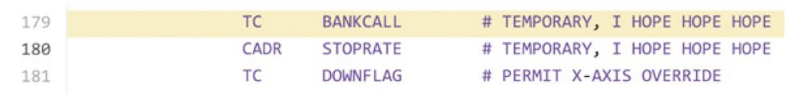
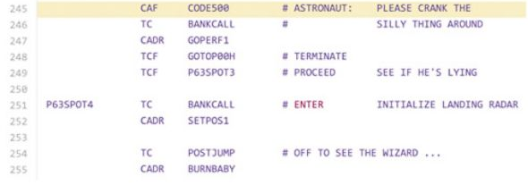

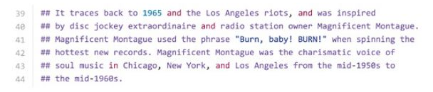
Aside: Apollo Guidance Computer
Margaret Hamilton Director of Software Engineering Division of MIT Instrumentation Laboratory
Built Apollo Guidance Computer Command Module (navigation, lunar landing)
72KB of memory on board Eagle (Apollo 11, 1969)
Margaret Hamilton and Apollo code
Wikimedia Commons
Presidential Medal of Freedom (2016)
ignition file
https://abcnews.go.com/Technology/apollo-11s-source-code-tons-easter-eggs-including/story?id=40515222
Notes:
https://www.smithsonianmag.com/smithsonian-institution/margaret-hamilton-led-nasa-software-team-landed-astronauts-moon-180971575/
https://www.ibiblio.org/apollo/assembly_language_manual.html
Obama is 6’2”

Slide 24
Immediates
The RISC-V Instruction Set Architecture
Elements of Architecture: Registers
Add/Sub Instructions
Immediates

Slide 25
Immediates
Immediates are numerical constants.
They appear often in code; hence, they have separate instructions.
Add Immediate instruction:
RISC-V
C
addi x3,x4,10
f = g + 10;
Syntax similar to add instruction. But the last operand must be a number, not a register.

Slide 26
Immediates
Immediates are numerical constants.
They appear often in code; hence, they have separate instructions.
Add Immediate instruction:
There is no Subtract Immediate instruction in RISC-V. Why?
While there are add and sub instructions, to subtract an immediate, just use addi:
RISC-V
C
addi x3,x4,10
f = g + 10;
Syntax similar to add instruction. But the last operand must be a number, not a register.
RISC-V
C
addi x3,x4,-10
f = g - 10;
RISC Philosophy: Reduce the possible types of operations to an absolute minimum.
If an operation can be decomposed into a simpler operation, don’t include it in the ISA.
Notes:
RISC: reduced instruction set computer

Slide 27
Register Zero
One particular immediate, the number zero (0), appears very often in code.
RISC-V hardwires the register zero (x0) to value 0:
Defined in hardware, so an instruction add x0,x3,x4 will not do anything!
RISC-V
C
add x3,x4,x0
f = g;
RISC-V
C
addi x3,x0,0xff
f = 0xff;

Slide 28
Concept Check: True or False?
Types are associated with declaration in C (normally), but are associated with instructions (operators) in RISC-V.
Since there are only 32 registers, we can’t write RISC-V for C expressions that contain > 32 variables.
If p (stored in x9) were a pointer to an array of ints, then p++; would be addi x9 x9 1

Slide 29
Concept Check: True or False?
Types are associated with declaration in C (normally), but are associated with instructions (operators) in RISC-V.
Since there are only 32 registers, we can’t write RISC-V for C expressions that contain > 32 variables.
If p (stored in x9) were a pointer to an array of ints, then p++; would be addi x9 x9 1
123
FFF
FFT
FTF
FTT
TFF
TFT
TTF
TTT
1. True, we saw that on an earlier slide.
2. False. we saw how to break up longer equations to smaller ones already.
3. False. Don’t forget that ints are (usually) 4 bytes wide, so instruction would be addi x9, x9, 4.
Notes:
1. True, we saw that on an early slide.
2. False. we saw how to break up longer equations to smaller ones already.
3. False. Don’t forget that ints are (usually) 4 bytes wide.

Slide 30
In Conclusion…
In RISC-V Assembly Language:
Registers replace C variables
One instruction (simple operation) per line
Simpler is Better, Smaller is Faster
In RV32, words are 32b
Instructions:
add, addi, sub
Registers:
32 registers, referred to as x0 – x31
Zero: x0

